Slide 1
CHAPTER EIGHT
INTRODUCTION TO LIFE SKILLS

Slide 2
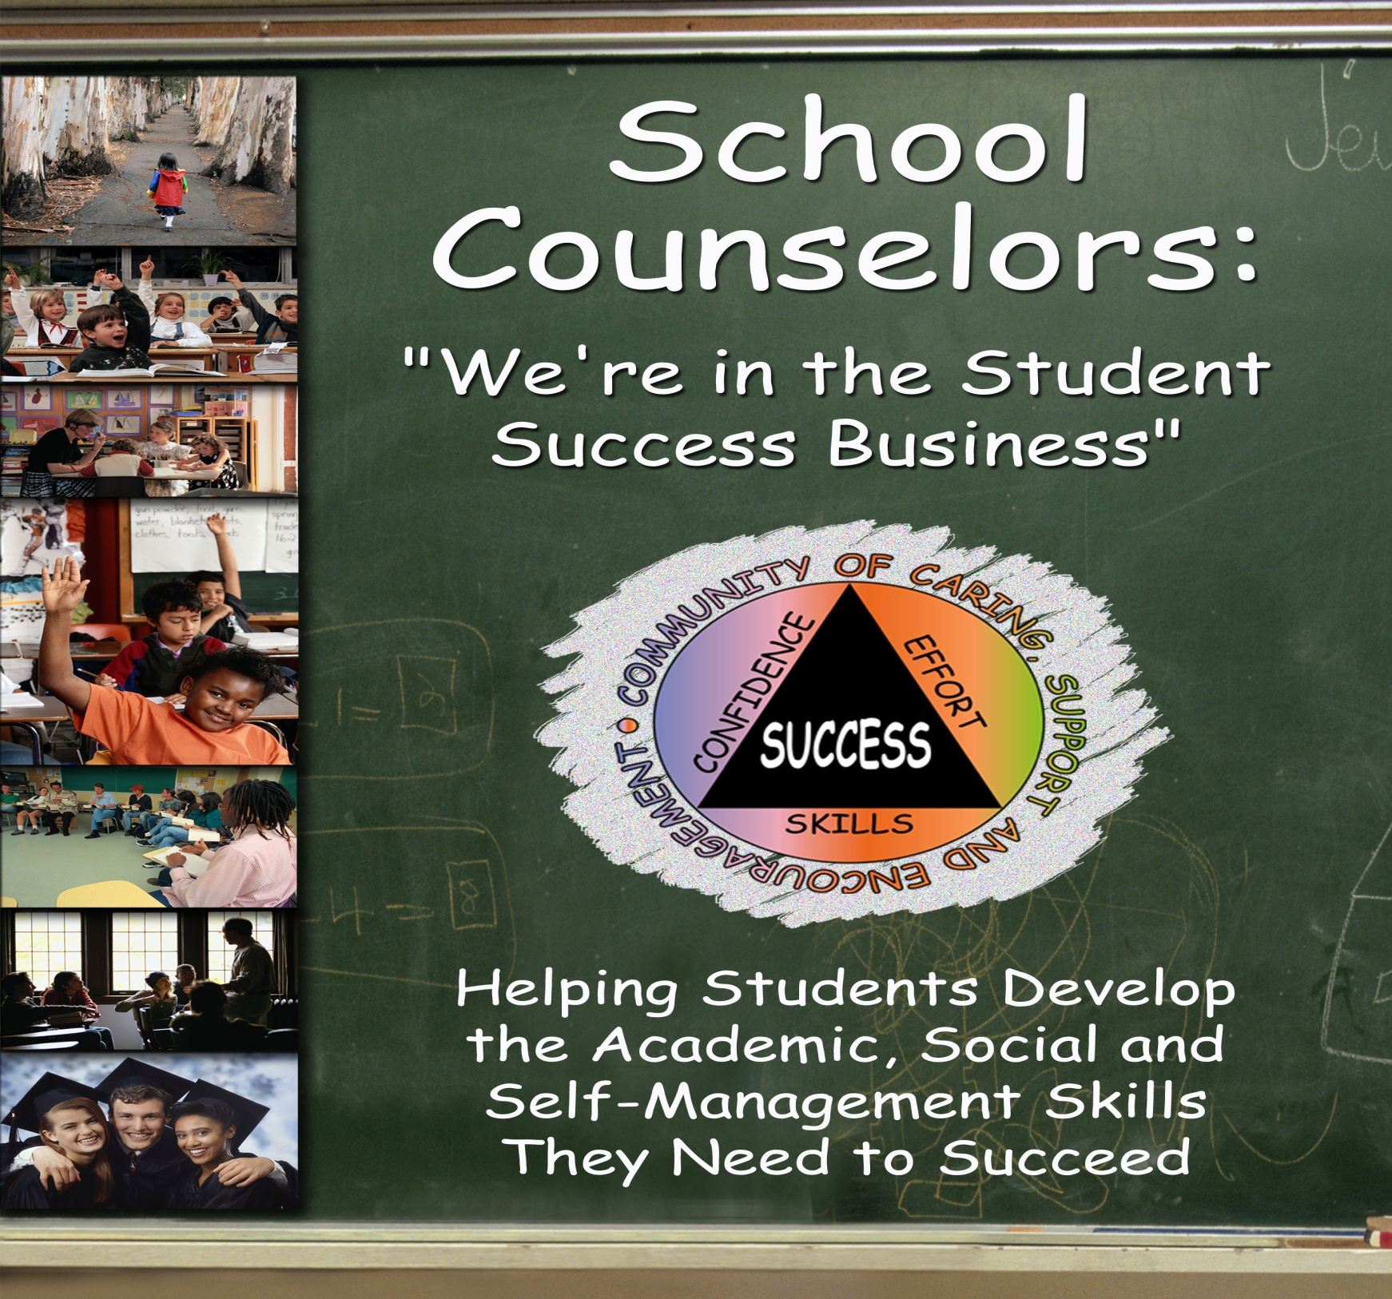
.

Slide 3
8.1. Nature and Definition of Life skills
Life skills are “abilities for adaptive and positive behavior that enable individuals to deal effectively with the demands and challenges of everyday life.” (WHO).
It is also defined as “behavioral changes or behavioral development approach designed to address a balance of three areas: knowledge attitude and skills” (UNICEF).
Life skills are tools at our hands that help us prevent, improve, and manage mind and behavior for effective psychological functioning.
Life skills are essentially those abilities that help to promote mental well-being and competence in young people as they face the realities of life.
Hence, students who are able to understand and use these skills, along with their educational qualifications, will be better placed to take advantage of educational & employment opportunities.

Slide 4
8.2. Goals of Life Skills
To live in harmony with ourselves and others around us, select the goods from the bad, choose gold from soil, simplify life etc.
To update our skills and knowledge of dealing with life events and lead a smooth and successful life at home and work places.
To empower young people to take positive action to protect themselves and promote health and positive social relationships.
To enable explore alternatives, consider pros and cons and make rational decisions in solving each problem or issue as it arises.

Slide 5
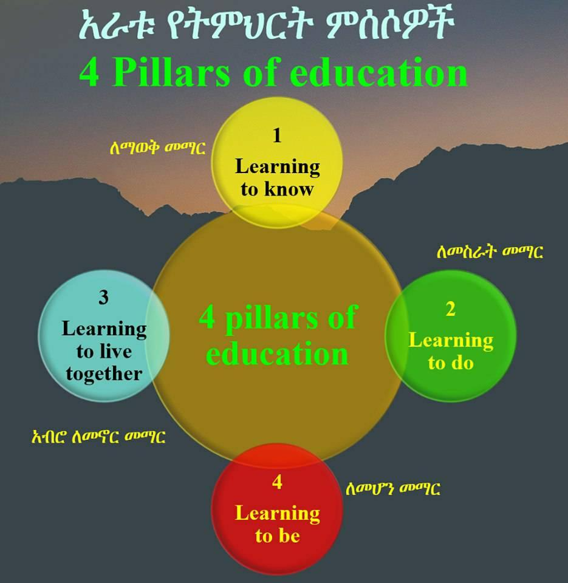

Slide 7
8.3. Components of Life Skills
1. Critical thinking
2. Self- confidence
3. Self-awareness
4. Self- esteem
5. Decision making
6. Interpersonal relationship
7. Reflective communication
8. Peer resistance
9. Knowing rights and duties
10. Problem solving
11. Stress management

Slide 8
1. Critical thinking
It refers to thinking more effectively within curricular subject areas, understanding the reasoning employed, assessing independently and appropriately, and solving problems effectively.
It involves, as well, improved thinking skills in dealing with real life problems in assessing information and arguments in social contexts and making life decisions.

Slide 9
2. Self-confidence
It is the degree to which one can rely on his/her ability to perform certain behavior alone or in public.
It is individual‘s trust in his or her own abilities, capacities, and judgments, or belief that he or she can successfully face day-to-day challenges and demands.

Slide 10
3. Self-awareness
It is self-focused attention or knowledge.
It is the knowledge and understanding of one‘s strengthens and weaknesses. Self-awareness involves monitoring our inner worlds, thoughts, emotions, and beliefs.
It is important, because it is a major mechanism influencing personal development.

Slide 11
4. Self-esteem
It is the degree to which we perceive ourselves positively or negatively; our overall attitude toward ourselves, which can be measured explicitly or implicitly.
It involves the degree to which the qualities and characteristics contained in one’s self-concept are perceived to be positive. It reflects a person’s physical self-image, view of his or her accomplishments and capabilities, and values and perceived success in living up to them, as well as the ways in which others view and respond to that person.
The more positive the cumulative perception of these qualities and characteristics, the higher one’s self-esteem.
A reasonably high degree of self-esteem is considered an important ingredient of mental health, whereas low self-esteem and feelings of worthlessness are common depressive symptoms.

Slide 12
5. Decision-making
It is a processes involved in combining and integrating available information to choose, implement and evaluate one out of several possible courses of actions.
Responsible Decision Making refers making decision after examining the choices & consequences in view of one’s values and goals.

Slide 13
6. Interpersonal relationships
It is the relationships a person have with others persons. They are social associations, connections, or affiliations between two or more people having various levels of intimacy and sharing, and implying the discovery or establishment of common ground.
It involves developing & nurturing supportive networks; ending relationships constructively; and helping individuals to relate with people in positive ways.

Slide 14
7. Reflective communication
It is attending communications with thoughtful and due attention to reflect on one‘s own thinking, behaviors and interaction with others.
It requires expressing ourselves verbally & non-verbally; our opinions, desires, needs & fears; and advice and help.

Slide 15
8. Peer pressure resistance
Indicates individual‘s abilities and skills to confront negative influences from his/her group members.
Take Pleasure & Pride in saying NO when one wants to say “no”.
9. Knowing rights and duties
It refers to one‘s knowledge and understanding of rights and duties of individuals, groups, institutions and nations allowed to do or not to do by law and/or a culture.

Slide 16
10. Problem solving
Refers to the process of identifying a discrepancy between an actual and desired state of affairs, difficulties, obstacles and complex issues and then taking action to resolve the deficiency or take advantage of the opportunity.
It is the process by which individuals attempt to overcome difficulties, achieve plans that move them from a starting situation to a desired goal, or reach conclusions through the use of higher mental functions.

Slide 17
11. Stress Management
Recognizing effects of emotions on others and ourselves.
Being aware of how emotions influence behaviors.
Able to respond to emotions appropriately.
How to Cope with Stress
Recognize sources of stress in our life
Recognizing how these affect us
Identifying ways that help to control our levels of stress
Learning how to relax to minimize tensions

Slide 18
Group the following into thinking, working, social and learning skills. Discuss the grouping in class.
a | b | c | d
Decision making Self- knowledge Critical thinking Accessing and analyzing information Stress management | ICT Agility and adaptability Receiving and giving feedback Handling criticism Innovation/exploration Learner autonomy | Cooperation People Management Time management Organization Negotiating Leading by influence | Citizenship Social responsibility Cultural awareness Social development Respecting diversity Networking

Slide 19
The Four Pillars of Education
Learning to Know: Developing Reasoning
It relates to cognitive life skills such as critical thinking, problem solving and decision making skills. It thus refers to both the acquisition of knowledge as well as the use of knowledge.
Learning to Be: Enhancing Agency
It relates to self-management life skills related to self awareness, self esteem & self confidence, and coping skills.
Learning to Live Together: Building Potential Through Social Capital
It relates to communication skills, Negotiation skills, Refusal skills, Assertiveness skills, Interpersonal skills, Co-operation skills & Empathy skills.
Learning to Do: Functioning and Capabilities
It refers to central human functional capabilities of “Life”, “Bodily Health”, “Bodily Integrity” and “Control over one’s Environment”.

Slide 20
.
THANK YOU!

